Slide 1
Computer Security:
Principles and Practice
Fourth Edition
By: William Stallings and Lawrie Brown
Notes:
Lecture slides prepared for “Computer Security: Principles and Practice”, 4/e, by William Stallings and Lawrie Brown, Chapter 20 “Symmetric Encryption and Message Confidentiality”.

Slide 2
Symmetric Encryption
Also referred to as:
Conventional encryption
Secret-key or single-key encryption
Only alternative before public-key encryption in 1970’s
Still most widely used alternative
Has five ingredients:
Plaintext
Encryption algorithm
Secret key
Ciphertext
Decryption algorithm
“class” the first position c has 64 possibilities
Class converted to hex key A52903bc20 has 0-255 values in first position and each position
Notes:
At this point the reader should review Section 2.1 . Recall that a symmetric
encryption scheme has five ingredients ( Figure 2.1 ):
• Plaintext: This is the original message or data that is fed into the algorithm as input.
• Encryption algorithm: The encryption algorithm performs various substitutions
and transformations on the plaintext.
• Secret key: The secret key is also input to the algorithm. The exact substitutions
and transformations performed by the algorithm depend on the key.
• Ciphertext: This is the scrambled message produced as output. It depends on
the plaintext and the secret key. For a given message, two different keys will
produce two different ciphertexts.
• Decryption algorithm: This is essentially the encryption algorithm run in
reverse. It takes the ciphertext and the same secret key and produces the
original plaintext.

Slide 3
Cryptography
Classified along three independent dimensions:
The type of operations used for transforming plaintext to ciphertext
Substitution – each element in the plaintext is mapped into another element
Transposition – elements in plaintext are rearranged
The number of keys used
Sender and receiver use same key – symmetric
Sender and receiver each use a different key - asymmetric
The way in which the plaintext is processed
Block cipher – processes input one block of elements at a time
Stream cipher – processes the input elements continuously
Notes:
Cryptographic systems are generically classified along three independent dimensions:
1. The type of operations used for transforming plaintext to ciphertext. All
encryption algorithms are based on two general principles: substitution,
in which each element in the plaintext (bit, letter, group of bits or letters)
is mapped into another element, and transposition, in which elements
in the plaintext are rearranged. The fundamental requirement is that no
information be lost (i.e., that all operations be reversible). Most systems,
referred to as product systems, involve multiple stages of substitutions and
transpositions.
2. The number of keys used. If both sender and receiver use the same key, the
system is referred to as symmetric, single-key, secret-key, or conventional
encryption. If the sender and receiver each use a different key, the system is
referred to as asymmetric, two-key, or public-key encryption.
3. The way in which the plaintext is processed. A block cipher processes the input
one block of elements at a time, producing an output block for each input
block. A stream cipher processes the input elements continuously, producing
output one element at a time, as it goes along.

Slide 4
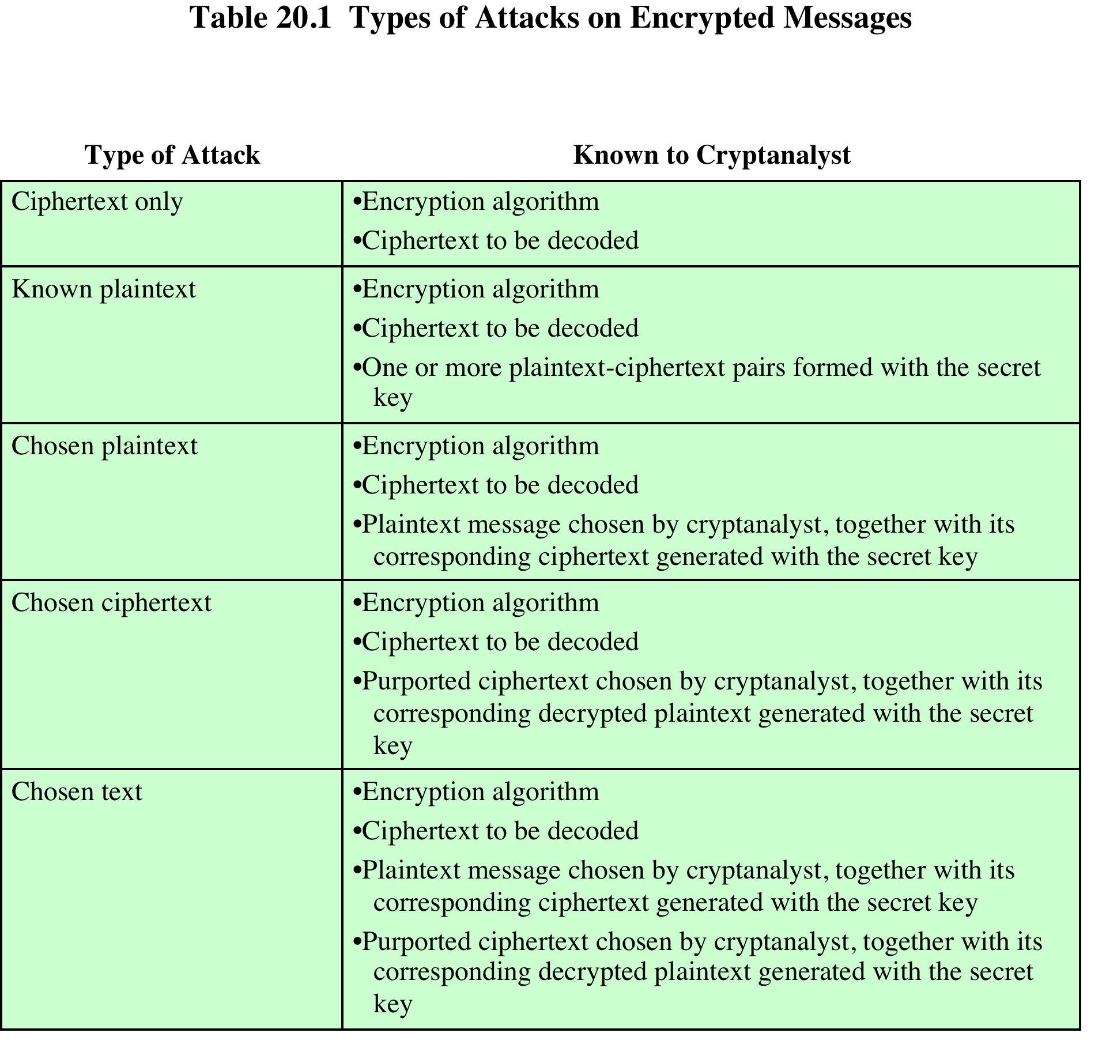
Notes:
The process of attempting to discover the plaintext or key is known as cryptanalysis .
The strategy used by the cryptanalyst depends on the nature of the encryption scheme
and the information available to the cryptanalyst.
Table 20.1 summarizes the various types of cryptanalytic attacks, based on
the amount of information known to the cryptanalyst. The most difficult problem
is presented when all that is available is the ciphertext only . In some cases, not even
the encryption algorithm is known, but in general we can assume that the opponent
does know the algorithm used for encryption. One possible attack under these circumstances
is the brute-force approach of trying all possible keys. If the key space
is very large, this becomes impractical. Thus, the opponent must rely on an analysis
of the ciphertext itself, generally applying various statistical tests to it. To use this
approach, the opponent must have some general idea of the type of plaintext that
is concealed, such as English or French text, an EXE file, a Java source listing, an
accounting file, and so on.
The ciphertext-only attack is the easiest to defend against because the opponent
has the least amount of information to work with. In many cases, however,
the analyst has more information. The analyst may be able to capture one or more
plaintext messages as well as their encryptions. Or the analyst may know that certain
plaintext patterns will appear in a message. For example, a file that is encoded
in the Postscript format always begins with the same pattern, or there may be a
standardized header or banner to an electronic funds transfer message, and so on.
All these are examples of known plaintext . With this knowledge, the analyst may
be able to deduce the key on the basis of the way in which the known plaintext is
transformed.
Closely related to the known-plaintext attack is what might be referred to as a
probable-word attack. If the opponent is working with the encryption of some general
prose message, he or she may have little knowledge of what is in the message.
However, if the opponent is after some very specific information, then parts of the
message may be known. For example, if an entire accounting file is being transmitted,
the opponent may know the placement of certain key words in the header of
the file. As another example, the source code for a program developed by a corporation
might include a copyright statement in some standardized position.
If the analyst is able somehow to get the source system to insert into
the system a message chosen by the analyst, then a chosen-plaintext attack is
possible. In general, if the analyst is able to choose the messages to encrypt,
the analyst may deliberately pick patterns that can be expected to reveal the
structure of the key.
Table 20.1 lists two other types of attack: chosen ciphertext and chosen text.
These are less commonly employed as cryptanalytic techniques but are nevertheless
possible avenues of attack.
Only relatively weak algorithms fail to withstand a ciphertext-only attack.
Generally, an encryption algorithm is designed to withstand a known-plaintext
attack.

Slide 5
Computationally Secure Encryption Schemes
Encryption is computationally secure if:
Cost of breaking cipher exceeds value of information
Time required to break cipher exceeds the useful lifetime of the information
Usually very difficult to estimate the amount of effort required to break
Can estimate time/cost of a brute-force attack
Notes:
An encryption scheme is computationally secure if the ciphertext generated
by the scheme meets one or both of the following criteria:
• The cost of breaking the cipher exceeds the value of the encrypted information.
• The time required to break the cipher exceeds the useful lifetime of the
information.
Unfortunately, it is very difficult to estimate the amount of effort required
to cryptanalyze ciphertext successfully. However, assuming there are no inherent
mathematical weaknesses in the algorithm, then a brute-force approach is indicated,
and here we can make some reasonable estimates about costs and time.
A brute-force approach involves trying every possible key until an intelligible
translation of the ciphertext into plaintext is obtained. On average, half of all
possible keys must be tried to achieve success. This type of attack is discussed in
Section 2.1 .

Slide 6
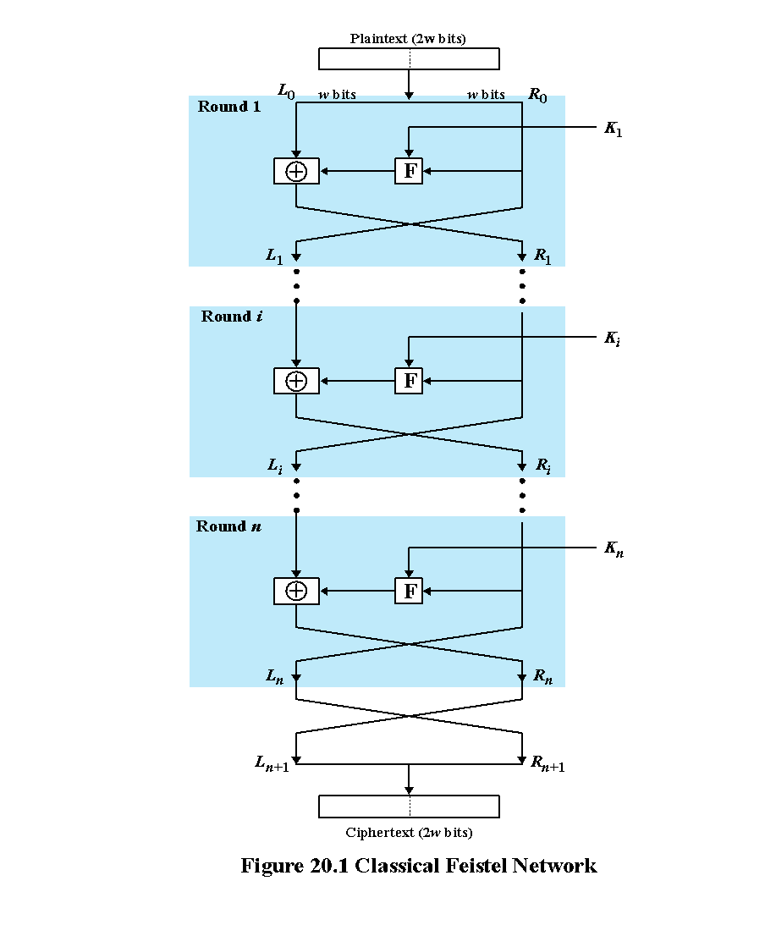
Notes:
Many symmetric block encryption algorithms, including DES, have a structure first
described by Horst Feistel of IBM in 1973 [FEIS73] and shown in Figure 20.1 . The
inputs to the encryption algorithm are a plaintext block of length 2 w bits and a key
K . The plaintext block is divided into two halves, L ₀ and R ₀ . The two halves of the
data pass through n rounds of processing and then combine to produce the ciphertext
block. Each round i has as inputs L _{i-1} and R _{i-1} , derived from the previous
round, as well as a subkey K_{i} , derived from the overall K . In general, the subkeys
K _{i} are different from K and from each other and are generated from the key by a
subkey generation algorithm.
All rounds have the same structure. A substitution is performed on the left
half of the data. This is done by applying a round function F to the right half of
the data and then taking the exclusive-OR (XOR) of the output of that function
and the left half of the data. The round function has the same general structure for
each round but is parameterized by the round subkey K _{i} . Following this substitution,
a permutation is performed that consists of the interchange of the two halves
of the data.

Slide 7
P=01100010
K=10011101
L0=0110
R0=0010 K0=1001 F= 1011
L1=R0
= 0010
R1=F xor L0
1011 xor
0110
= 1101
Notes:
Many symmetric block encryption algorithms, including DES, have a structure first
described by Horst Feistel of IBM in 1973 [FEIS73] and shown in Figure 20.1 . The
inputs to the encryption algorithm are a plaintext block of length 2 w bits and a key
K . The plaintext block is divided into two halves, L ₀ and R ₀ . The two halves of the
data pass through n rounds of processing and then combine to produce the ciphertext
block. Each round i has as inputs L _{i-1} and R _{i-1} , derived from the previous
round, as well as a subkey K_{i} , derived from the overall K . In general, the subkeys
K _{i} are different from K and from each other and are generated from the key by a
subkey generation algorithm.
All rounds have the same structure. A substitution is performed on the left
half of the data. This is done by applying a round function F to the right half of
the data and then taking the exclusive-OR (XOR) of the output of that function
and the left half of the data. The round function has the same general structure for
each round but is parameterized by the round subkey K _{i} . Following this substitution,
a permutation is performed that consists of the interchange of the two halves
of the data.

Slide 8
https://asecuritysite.com/symmetric/fei

Slide 9
Block Cipher Structure
Symmetric block cipher consists of:
A sequence of rounds
With substitutions and permutations controlled by key
Parameters and design features:
Block cipher is like text message or http response
Stream cipher is like a Netflix stream, a phone call
Block size
Key size
Number of rounds
Subkey generation algorithm
Ease of analysis
Fast software encryption/decryption
Round function
Notes:
The Feistel structure is a particular example of the more general structure
used by all symmetric block ciphers. In general, a symmetric block cipher consists of
a sequence of rounds, with each round performing substitutions and permutations
conditioned by a secret key value. The exact realization of a symmetric block cipher
depends on the choice of the following parameters and design features:
• Block size: Larger block sizes mean greater security (all other things being
equal) but reduced encryption/decryption speed. A block size of 128 bits
is a reasonable tradeoff and is nearly universal among recent block cipher
designs.
• Key size: Larger key size means greater security but may decrease encryption/
decryption speed. The most common key length in modern algorithms is
128 bits.
• Number of rounds: The essence of a symmetric block cipher is that a single
round offers inadequate security but that multiple rounds offer increasing
security. A typical size is 16 rounds.
• Subkey generation algorithm : Greater complexity in this algorithm should
lead to greater difficulty of cryptanalysis.
• Round function: Again, greater complexity generally means greater resistance
to cryptanalysis.
There are two other considerations in the design of a symmetric block cipher:
• Fast software encryption/decryption: In many cases, encryption is embedded in
applications or utility functions in such a way as to preclude a hardware implementation.
Accordingly, the speed of execution of the algorithm becomes a
concern.
• Ease of analysis: Although we would like to make our algorithm as difficult as
possible to cryptanalyze, there is great benefit in making the algorithm easy to
analyze. That is, if the algorithm can be concisely and clearly explained, it is
easier to analyze that algorithm for cryptanalytic vulnerabilities and therefore
develop a higher level of assurance as to its strength. DES, for example, does
not have an easily analyzed functionality.
Decryption with a symmetric block cipher is essentially the same as the
encryption process. The rule is as follows: Use the ciphertext as input to the
algorithm, but use the subkeys K _{i} in reverse order. That is, use K _{n} in the first round,
K _{n-1} in the second round, and so on until K ₁ is used in the last round. This is a nice
feature because it means we need not implement two different algorithms, one for
encryption and one for decryption.

Slide 10
Block Cipher
plaintext
01101011001100111010101100110011101010101000011101010101100011011011011011011111
0110101100110011 1010101100110011 1010101010000111 0101010110001101 1011011011011111
e
e
e
e
e
0011011011011111 1110101100110011 0010101100110011 1010101010000110 1101010110001101
CIPHER TEXT

Slide 11
Adopted in 1977 by National Bureau of Standards (Now NIST)
FIPS PUB 46
Algorithm is referred to as the Data Encryption Algorithm (DEA)
Minor variation of the Feistel network
Data Encryption Standard (DES)
Notes:
The most commonly used encryption scheme is based on the Data Encryption Standard
(DES) adopted in 1977 by the National Bureau of Standards, now the National
Institute of Standards and Technology (NIST), as FIPS 46 (Data Encryption Standard, January 1977).
The algorithm itself is referred to as the Data Encryption Algorithm (DEA).
The DES algorithm can be described as follows. The plaintext is 64 bits in
length and the key is 56 bits in length; longer plaintext amounts are processed in
64-bit blocks. The DES structure is a minor variation of the Feistel network shown
in Figure 20.1 . There are 16 rounds of processing. From the original 56-bit key, 16
subkeys are generated, one of which is used for each round.
The process of decryption with DES is essentially the same as the encryption
process. The rule is as follows: Use the ciphertext as input to the DES
algorithm, but use the subkeys K _{i} in reverse order. That is, use K ₁₆ on the first
iteration, K ₁₅ on the second iteration, and so on until K ₁ is used on the sixteenth
and last iteration.

Slide 12
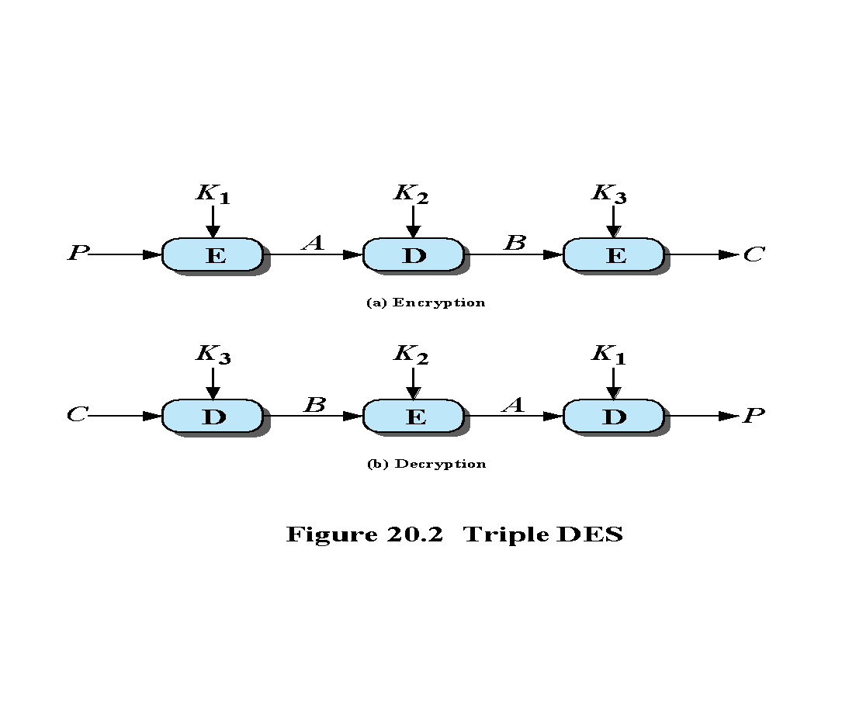
Notes:
Triple DES (3DES) was first standardized for use in financial applications in ANSI standard X9.17 in 1985. 3DES was incorporated as part of the Data Encryption Standard in 1999, with the publication of FIPS PUB 46-3.
3DES uses three keys and three executions of the DES algorithm. The function follows an encrypt-decrypt-encrypt (EDE) sequence (see Figure 20.2a):
C = E(K₃, D(K₂, E(K₁, P)))
where: C = ciphertext; P = plaintext; E[K, X] = encryption of X using key K, and D[K, Y] = decryption of Y using key K.
Decryption is simply the same operation with the keys reversed (Figure 20.2b):
P = D(K₁, E(K₂, D(K₃, C)))
There is no cryptographic significance to the use of decryption for the second stage of 3DES encryption. Its only advantage is that it allows users of 3DES to decrypt data encrypted by users of the older single DES:
C = E(K₁, D(K₁, E(K₁, P))) = E[K, P]
With three distinct keys, 3DES has an effective key length of 168 bits. FIPS 46-3 also allows for the use
of two keys, with K₁ = K₃; this provides for a key length of 112 bits. FIPS 46-3 includes the following guidelines for 3DES:
• 3DES is the FIPS approved symmetric encryption algorithm of choice.
• The original DES, which uses a single 56-bit key, is permitted under the standard
for legacy systems only. New procurements should support 3DES.
• Government organizations with legacy DES systems are encouraged to
transition to 3DES.
• It is anticipated that 3DES and the Advanced Encryption Standard (AES) will
coexist as FIPS-approved algorithms, allowing for a gradual transition to AES.
It is easy to see that 3DES is a formidable algorithm. Because the underlying
cryptographic algorithm is DEA, 3DES can claim the same resistance to cryptanalysis
based on the algorithm as is claimed for DEA. Further, with a 168-bit key length,
brute-force attacks are effectively impossible.
Ultimately, AES is intended to replace 3DES, but this process will take a
number of years. NIST anticipates that 3DES will remain an approved algorithm
(for U.S. government use) for the foreseeable future.

Slide 13
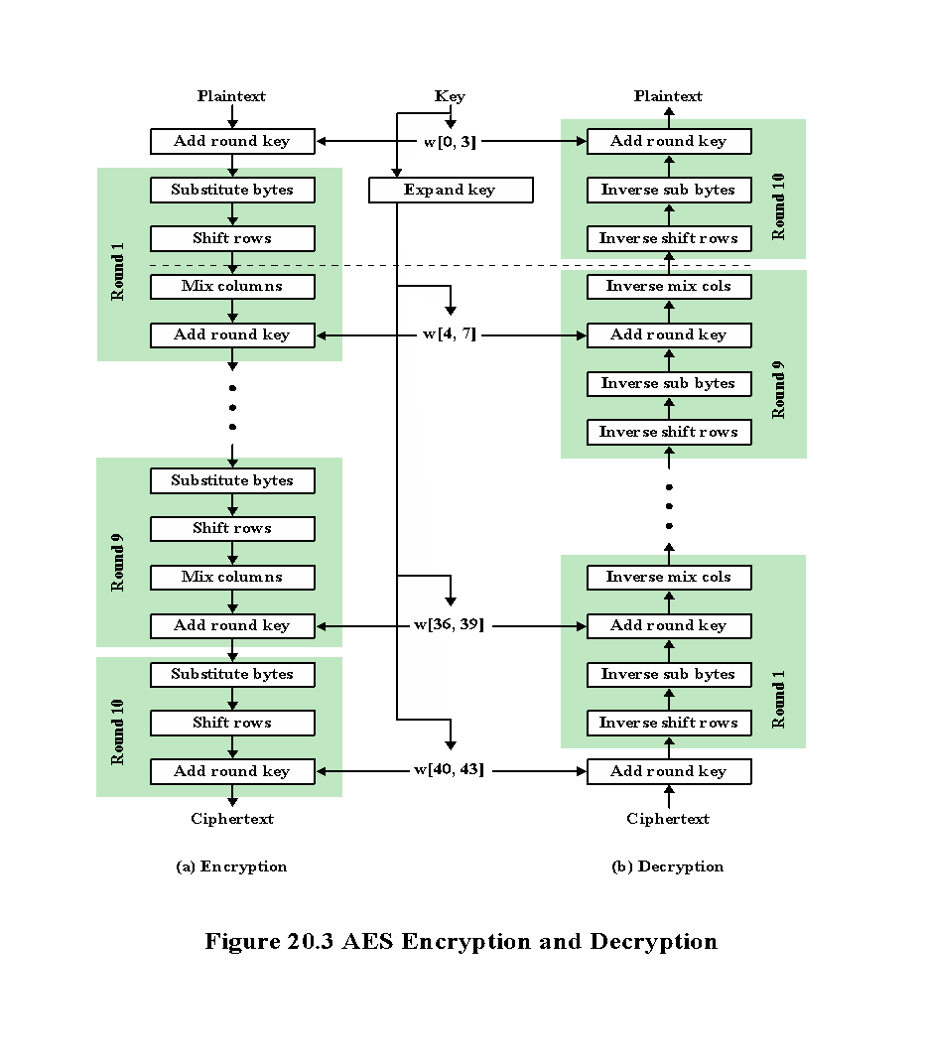
Notes:
The Advanced Encryption Standard (AES) was issued as a federal information processing
standard FIPS 197 (Advanced Encryption Standard, November 2001).
It is intended to replace DES and triple DES with an
algorithm that is more secure and efficient.
AES uses a block length of 128 bits and a key length that can be 128, 192, or 256 bits.
In the description of this section, we assume a key length of 128 bits, which is likely
to be the one most commonly implemented.
Figure 20.3 shows the overall structure of AES. The input to the encryption
and decryption algorithms is a single 128-bit block. In FIPS PUB 197, this block is
depicted as a square matrix of bytes. This block is copied into the State array, which
is modified at each stage of encryption or decryption. After the final stage, State is
copied to an output matrix. Similarly, the 128-bit key is depicted as a square matrix
of bytes. This key is then expanded into an array of key schedule words; each word
is 4 bytes and the total key schedule is 44 words for the 128-bit key. The ordering
of bytes within a matrix is by column. So, for example, the first 4 bytes of a 128-bit
plaintext input to the encryption cipher occupy the first column of the in matrix,
the second 4 bytes occupy the second column, and so on. Similarly, the first 4 bytes
of the expanded key, which form a word, occupy the first column of the w matrix.
The following comments give some insight into AES:
1. One noteworthy feature of this structure is that it is not a Feistel structure.
Recall that in the classic Feistel structure, half of the data block is used to
modify the other half of the data block, and then the halves are swapped. AES
does not use a Feistel structure but processes the entire data block in parallel
during each round using substitutions and permutation.
2. The key that is provided as input is expanded into an array of forty-four 32-bit
words, w [ i ]. Four distinct words (128 bits) serve as a round key for each round.
3. Four different stages are used, one of permutation and three of substitution:
• Substitute Bytes: Uses a table, referred to as an S-box, to perform a byte-by-
byte substitution of the block
• Shift Rows: A simple permutation that is performed row by row
• Mix Columns: A substitution that alters each byte in a column as a function
of all of the bytes in the column
• Add Round key: A simple bitwise XOR of the current block with a portion
of the expanded key

Slide 14
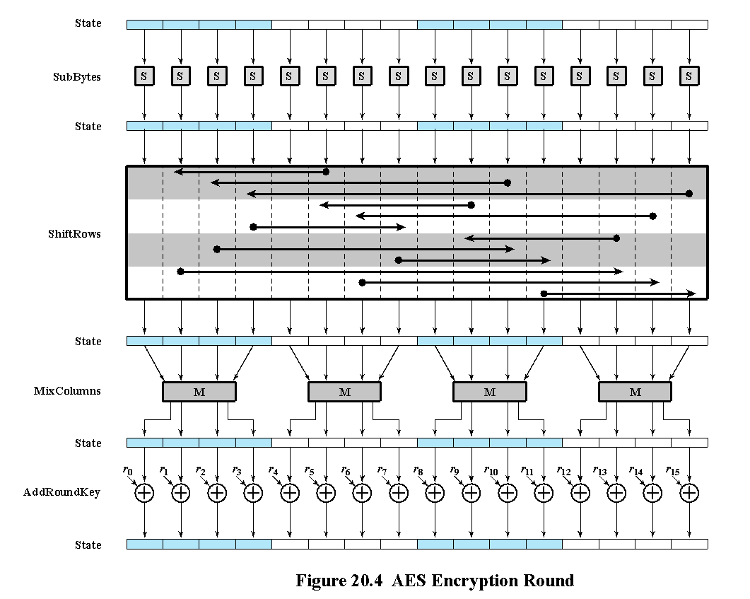
Notes:
4. The structure is quite simple. For both encryption and decryption, the cipher
begins with an Add Round Key stage, followed by nine rounds that each
includes all four stages, followed by a tenth round of three stages. Figure 20.4
depicts the structure of a full encryption round.
5. Only the Add Round Key stage makes use of the key. For this reason, the
cipher begins and ends with an Add Round Key stage. Any other stage,
applied at the beginning or end, is reversible without knowledge of the key
and so would add no security.
6. The Add Round Key stage by itself would not be formidable. The other three
stages together scramble the bits, but by themselves would provide no security
because they do not use the key. We can view the cipher as alternating operations
of XOR encryption (Add Round Key) of a block, followed by scrambling
of the block (the other three stages), followed by XOR encryption, and
so on. This scheme is both efficient and highly secure.
7. Each stage is easily reversible. For the Substitute Byte, Shift Row, and Mix
Columns stages, an inverse function is used in the decryption algorithm. For
the Add Round Key stage, the inverse is achieved by XORing the same round
key to the block, using the result that A ⊕ A ⊕ B = B.
8. As with most block ciphers, the decryption algorithm makes use of the
expanded key in reverse order. However, the decryption algorithm is not
identical to the encryption algorithm. This is a consequence of the particular
structure of AES.
9. Once it is established that all four stages are reversible, it is easy to verify
that decryption does recover the plaintext. Figure 20.3 lays out encryption
and decryption going in opposite vertical directions. At each horizontal point
(e.g., the dashed line in the figure), State is the same for both encryption and
decryption.
10. The final round of both encryption and decryption consists of only three
stages. Again, this is a consequence of the particular structure of AES and is
required to make the cipher reversible.

Slide 15
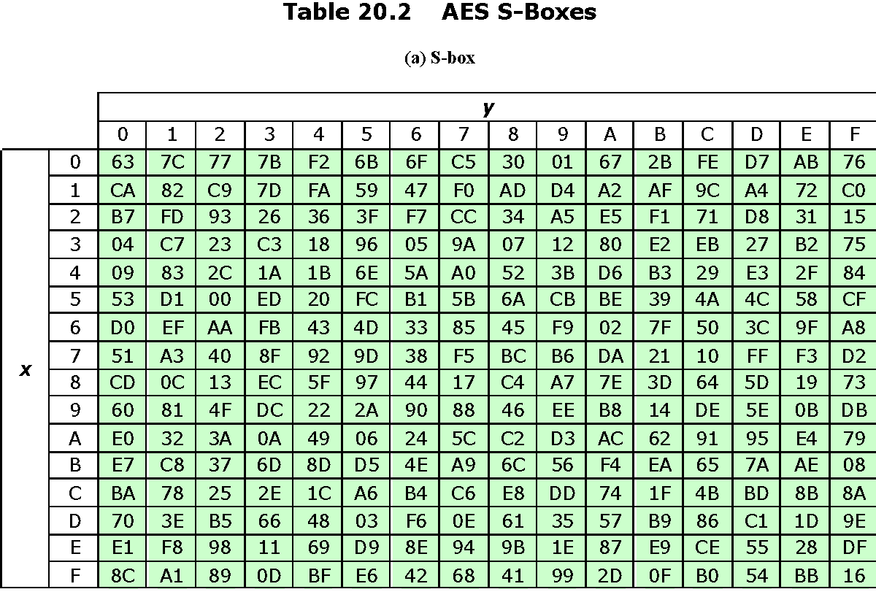
Notes:
The forward substitute byte transformation,
called SubBytes, is a simple table lookup. AES defines a 16·16 matrix of byte values,
called an S-box ( Table 20.2a ), that contains a permutation of all possible 256 8-bit
values. Each individual byte of State is mapped into a new byte in the following
way: The leftmost 4 bits of the byte are used as a row value and the rightmost 4
bits are used as a column value. These row and column values serve as indexes
into the S-box to select a unique 8-bit output value. For example, the hexadecimal
value {95} references row 9, column 5 of the S-box, which contains the value {2A}.
Accordingly, the value {95} is mapped into the value {2A}.

Slide 16
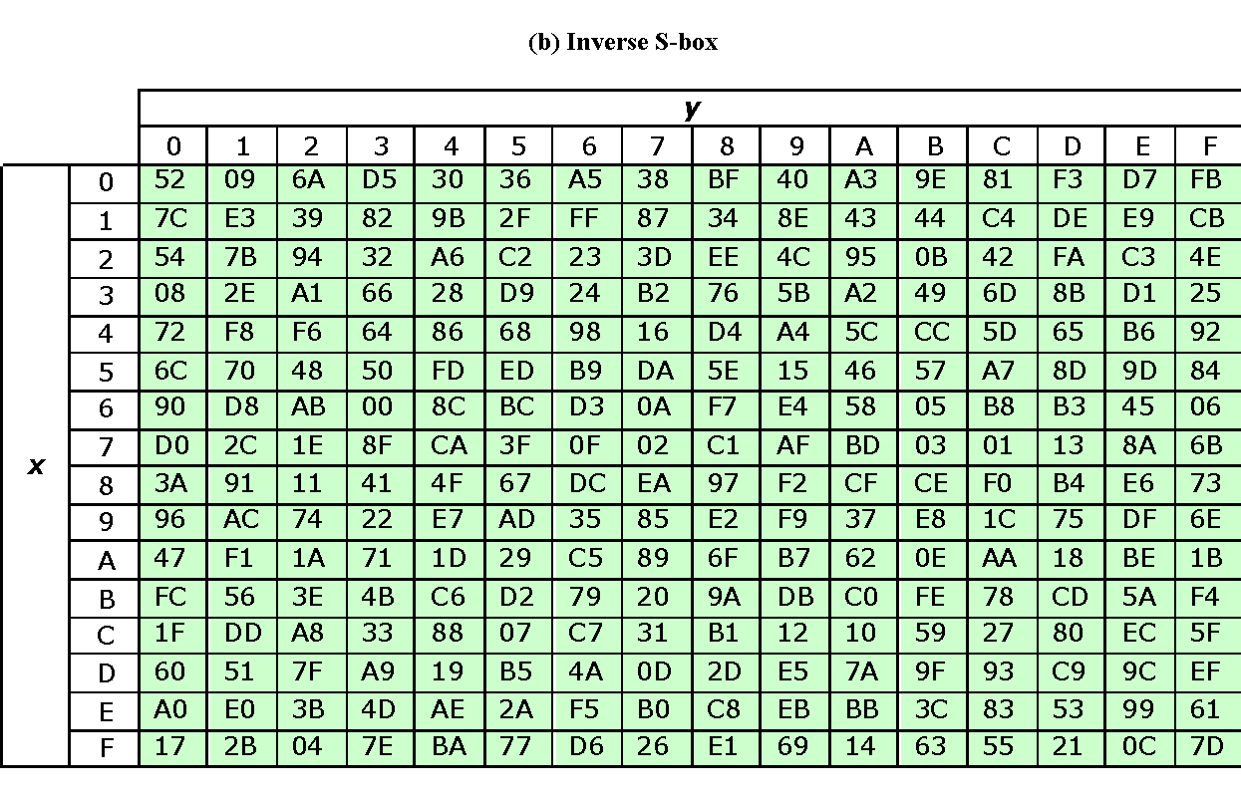
Table 20.2 AES S-Boxes
Table 20.2 AES S-Boxes
Notes:
The inverse substitute byte transformation, called InvSubBytes, makes use of
the inverse S-box shown in Table 20.2b . Note, for example, that the input {2A} produces
the output {95}, and the input {95} to the S-box produces {2A}.
The S-box is designed to be resistant to known cryptanalytic attacks.
Specifically, the AES developers sought a design that has a low correlation between
input bits and output bits and the property that the output cannot be described as a
simple mathematical function of the input.

Slide 17
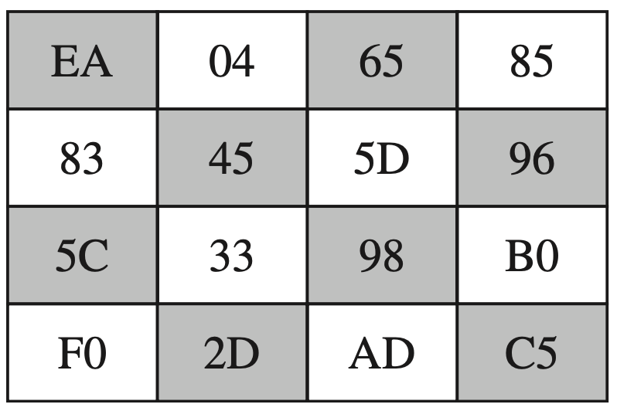
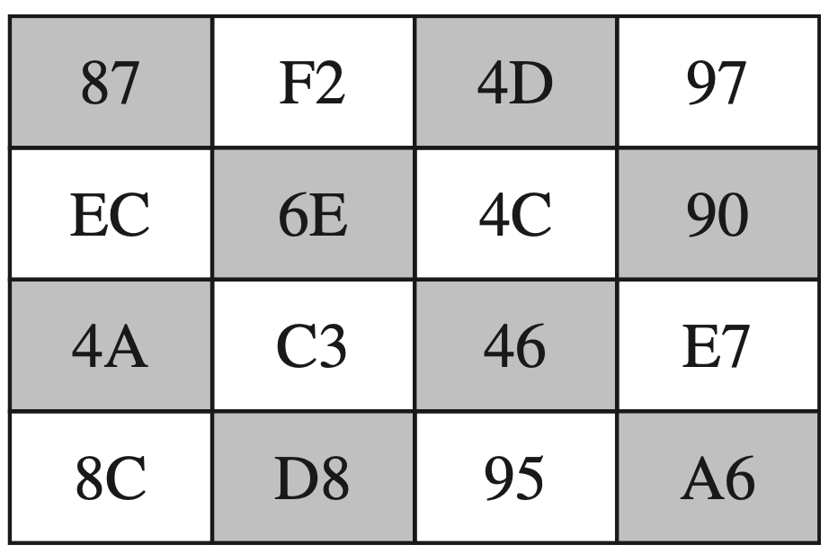
Convert this 16 byte data using s-box

Slide 18
Shift Rows
To move individual bytes from one column to another and spread bytes over columns
Decryption does reverse
On encryption left rotate each row of State by 0,1,2,3 bytes respectively
Notes:
For the forward shift row transformation, called ShiftRows, the first row of State is not altered. For the second row, a 1-byte circular left shift is performed. For the third row, a 2-byte circular left shift is performed. For the third row, a 3-byte circular left shift is performed.
The inverse shift row transformation, called InvShiftRows, performs the circular shifts in the opposite direction for each of the last three rows, with a one-byte circular right shift for the second row, and so on.
The shift row transformation is more substantial than it may first appear. This is because the State, as well as the cipher input and output, is treated as an array of four 4-byte columns. Thus, on encryption, the first four bytes of the plaintext are copied to the first column of State, and so on. Further, as will be seen, the round key is applied to State column by column. Thus, a row shift moves an individual byte from one column to another, which is a linear distance of a multiple of 4 bytes. Also note that the transformation ensures that the four bytes of one column are spread out to four different columns.

Slide 19
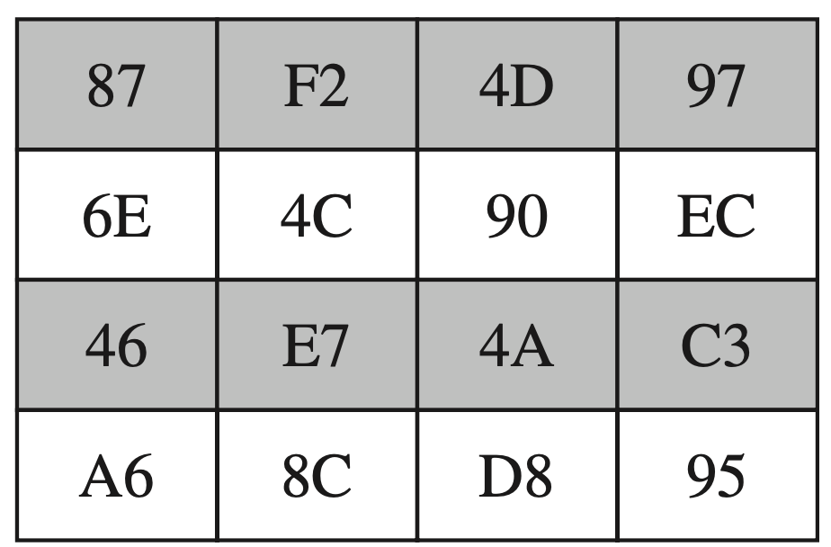
Do Shift row transformation

Slide 20
Mix Columns and Add Key
Mix columns
Operates on each column individually
Mapping each byte to a new value that is a function of all four bytes in the column
Use of equations over finite fields
To provide good mixing of bytes in column
Add round key
Simply XOR State with bits of expanded key
Security from complexity of round key expansion and other stages of AES
Notes:
The forward mix column transformation, called MixColumns, operates on each column individually. Each byte of a column is mapped into a new value that is a function of all four bytes in the column. The mapping makes use of equations over finite fields. The mapping is designed to provide a good mixing among the bytes of each column. The mix column transformation combined with the shift row transformation ensures that after a few rounds, all output bits depend on all input bits.
In the forward add round key transformation, called AddRoundKey, the 128 bits of State are bitwise XORed with the 128 bits of the round key. The operation is viewed as a column-wise operation between the four bytes of a State column and one word of the round key; it can also be viewed as a byte-level operation.
The inverse add round key transformation is identical to the forward add round key transformation, because the XOR operation is its own inverse.
The add round key transformation is as simple as possible and affects every bit of State. The complexity of the round key expansion, plus the complexity of the other stages of AES, ensure security.
The AES key expansion algorithm takes as input a 4-word
(16-byte) key and produces a linear array of 44 words (156 bytes). This is sufficient
to provide a 4-word round key for the initial Add Round Key stage and each of the
10 rounds of the cipher.
The key is copied into the first four words of the expanded key. The remainder
of the expanded key is filled in four words at a time. Each added word w [i] depends on
the immediately preceding word, w [i – 1], and the word four positions back, w [i – 4]. A
complex finite-field algorithm is used in generating the expanded key.

Slide 21
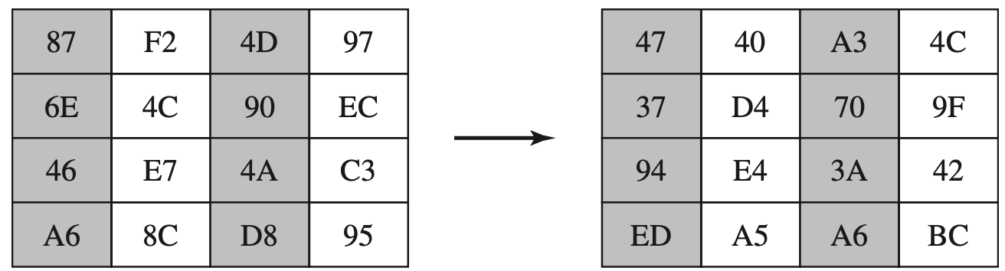
Mix columns
02 | 03 | 01 | 01 |  | R1 |  | A1
01 | 02 | 03 | 01 | * | R2 | = | A2
01 | 01 | 02 | 03 |  | R3 |  | A3
03 | 01 | 01 | 02 |  | R4 |  | A4

Slide 22
Mix columns
02 | 03 | 01 | 01 |  | 87 |  | 47
01 | 02 | 03 | 01 | * | 6E | = | 37
01 | 01 | 02 | 03 |  | 46 |  | 94
03 | 01 | 01 | 02 |  | A6 |  | ED
binary multiplication = Left shift one bit. If leading bit is 1, xor with 00011011

Slide 23
Mix columns
02 | 03 | 01 | 01 |  | 87 |  | 47
01 | 02 | 03 | 01 | * | 6E | = | 37
01 | 01 | 02 | 03 |  | 46 |  | 94
03 | 01 | 01 | 02 |  | A6 |  | ED
R0C1 = 02 * 87 + 03 * 63 + 01 * 46 + 01 * A6
02 * 87 = 1000 0111 -> 0000 1111 + 0001 1011 = 0001 0101
03 * 6E = (02+01)6E = 02*6E + 01*6E = 1101 1100 + 0110 1110 + 0110 1110 = 1011 0010
01 * 46 = 46 = 0100 0110
01 * a6 = a6 = 1010 0110
0 0 0 1 0 1 0 1
1 0 1 1 0 0 1 0
0 1 0 0 0 1 1 0
1 0 1 0 0 1 1 0
---------------
0 1 0 0 0 1 1 1 = 47 So R0,C0 answer is 47 which matches example.

Slide 24
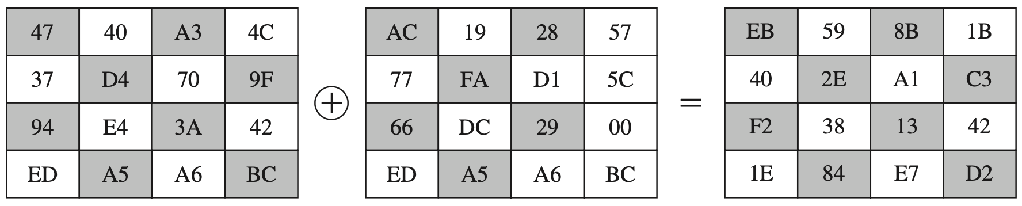
Add round key
47 + ac =
0 1 0 0 0 1 1 1
1 0 1 0 1 1 0 0
---------------------
1 1 1 0 1 0 1 1 = EB

Slide 25
Stream Ciphers
Processes input elements continuously
Key input to a pseudorandom bit generator
Produces stream of random like numbers
Unpredictable without knowing input key
XOR keystream output with plaintext bytes
Notes:
A block cipher processes the input one block of elements at a time, producing an
output block for each input block. A stream cipher processes the input elements
continuously, producing output one element at a time, as it goes along. Although
block ciphers are far more common, there are certain applications in which a
stream cipher is more appropriate. Examples are given subsequently in this book.
In this section, we look at perhaps the most popular symmetric stream cipher,
RC4. We begin with an overview of stream cipher structure and then examine
RC4.
A typical stream cipher encrypts plaintext 1 byte at a time, although a stream cipher
may be designed to operate on 1 bit at a time or on units larger than a byte at a time.
Figure 2.3b is a representative diagram of stream cipher structure. In this structure
a key is input to a pseudorandom bit generator that produces a stream of 8-bit
numbers that are apparently random. A pseudorandom stream is one that is unpredictable
without knowledge of the input key and that has an apparently random
character. The output of the generator, called a keystream, is combined 1 byte at
a time with the plaintext stream using the bitwise exclusive-OR (XOR) operation.

Slide 26
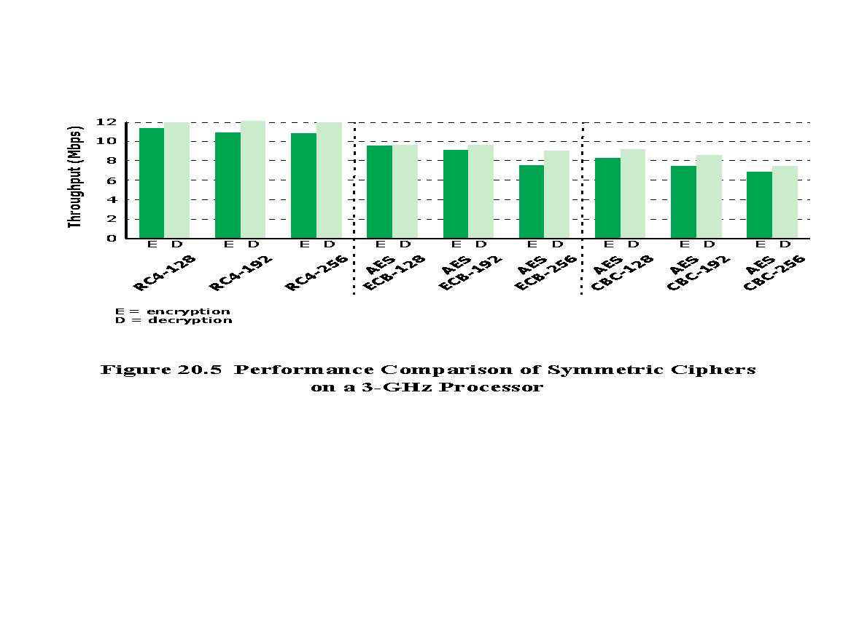
Notes:
RC4 is a stream cipher designed in 1987 by Ron Rivest for RSA Security. It is a variable key-size stream cipher with byte-oriented operations. The algorithm is based on the use of a random permutation. Analysis shows that the period of the cipher is overwhelmingly likely to be greater than 10¹⁰⁰ [ROBS95]. Eight to sixteen machine operations are required per output byte, and the cipher can be expected to run very quickly in software. RC4 is used in the SSL/TLS (Secure Sockets Layer/Transport Layer Security) standards that have been defined for communication between Web browsers and servers. It is also used in the WEP (Wired Equivalent Privacy) protocol and the newer WiFi Protected Access (WPA) protocol that are part of the IEEE
802.11 wireless LAN standard. RC4 was kept as a trade secret by RSA Security. In
September 1994, the RC4 algorithm was anonymously posted on the Internet on the
Cypherpunks anonymous remailers list.
The RC4 algorithm is remarkably simply and quite easy to explain. A variable-length key of from 1 to 256 bytes (8 to 2048 bits) is used to initialize a 256-byte state vector S, with elements S[0], S[1], …, S[255]. At all times, S contains a permutation of all 8-bit numbers from 0 through 255. For encryption and decryption, a byte k (see Figure 2.3b) is generated from S by selecting one of the 255 entries
in a systematic fashion. As each value of k is generated, the entries in S are once
again permuted.
To begin, the entries of S are set equal to the values from
0 through 255 in ascending order; that is, S [0] = 0, S [1] = 1, . . . , S [255] = 255.
A temporary vector, T, is also created. If the length of the key K is 256 bytes,
then K is transferred to T. Otherwise, for a key of length keylen bytes, the first
keylen elements of T are copied from K and then K is repeated as many times
as necessary to fill out T. These preliminary operations can be summarized as
follows:
/* Initialization */
for i = 0 to 255 do
S[i] =i;
T[i] = K[i mod keylen];
Next we use T to produce the initial permutation of S. This involves starting
with S[0] and going through to S[255], and, for each S [i], swapping S [i] with another
byte in S according to a scheme dictated by T[i]:
/* Initial Permutation of S */
j = 0;
for i = 0 to 255 do
j = (j + S[i] + T[i]) mod 256;
Swap (S[i], S[j]);
Because the only operation on S is a swap, the only effect is a permutation.
S still contains all the numbers from 0 through 255.
Once the S vector is initialized, the input key is no longer
used. Stream generation involves cycling through all the elements of S [i], and, for
each S [i], swapping S [i] with another byte in S according to a scheme dictated by the
current configuration of S. After S[255] is reached, the process continues, starting
over again at S[0]:
/* Stream Generation */
i, j = 0;
while (true)
i = (i + 1) mod 256;
j = (j + S[i]) mod 256;
Swap (S[i], S[j]);
t = (S[i] + S[j]) mod 256;
k = S[t];
To encrypt, XOR the value k with the next byte of plaintext. To decrypt, XOR
the value k with the next byte of ciphertext.
Figure 20.5 illustrates the RC4 logic.

Slide 27
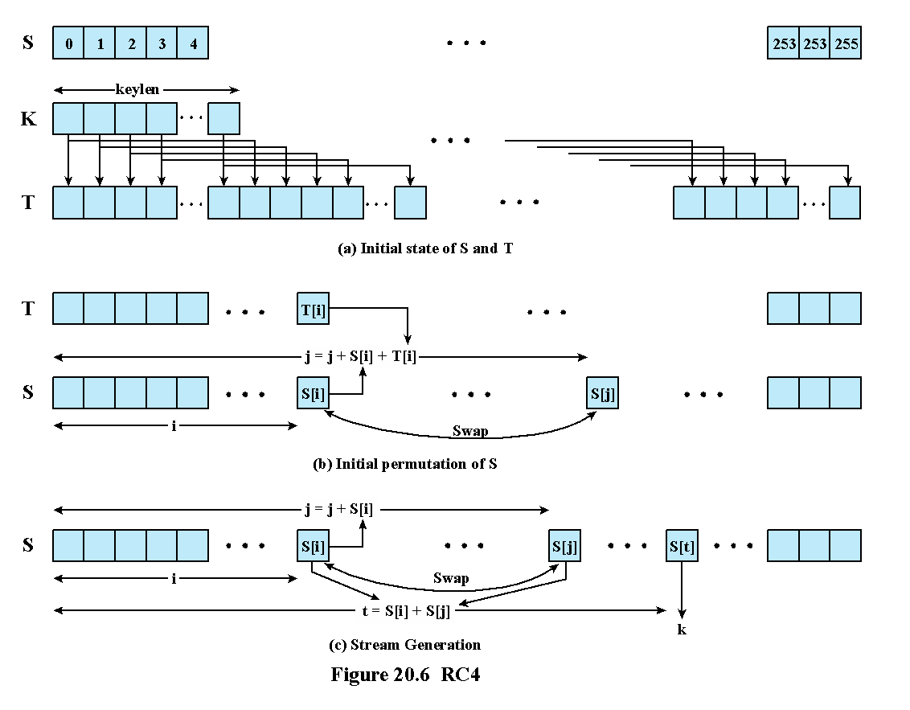
Notes:
Figure 20.6 illustrates the RC4 logic.

Slide 28
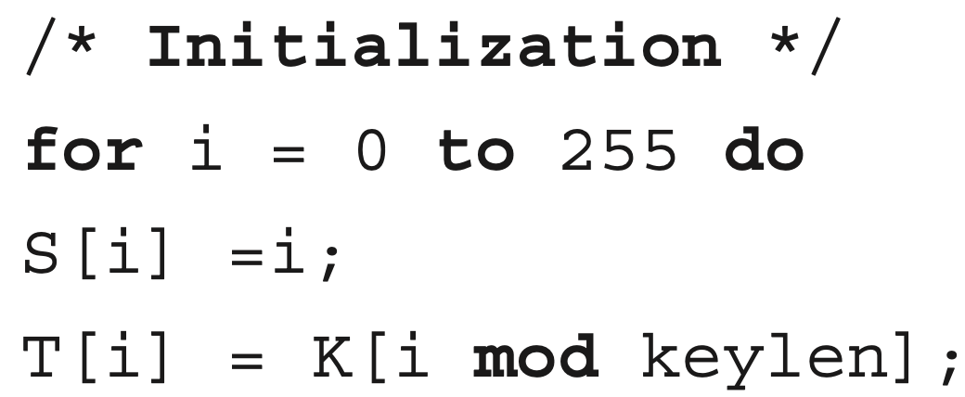
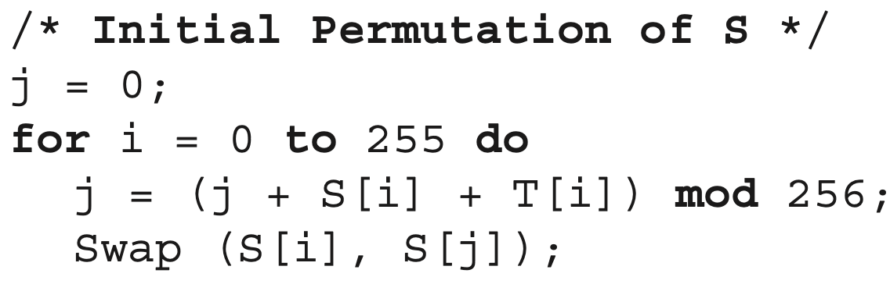
Initialization of S

Slide 29
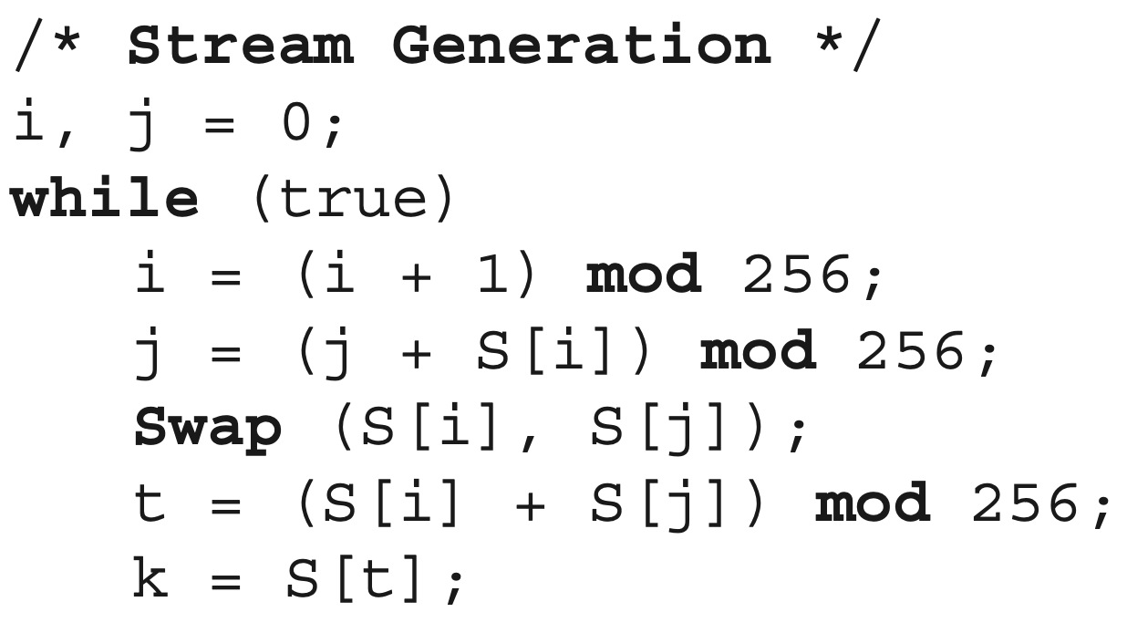
Stream generation

Slide 30
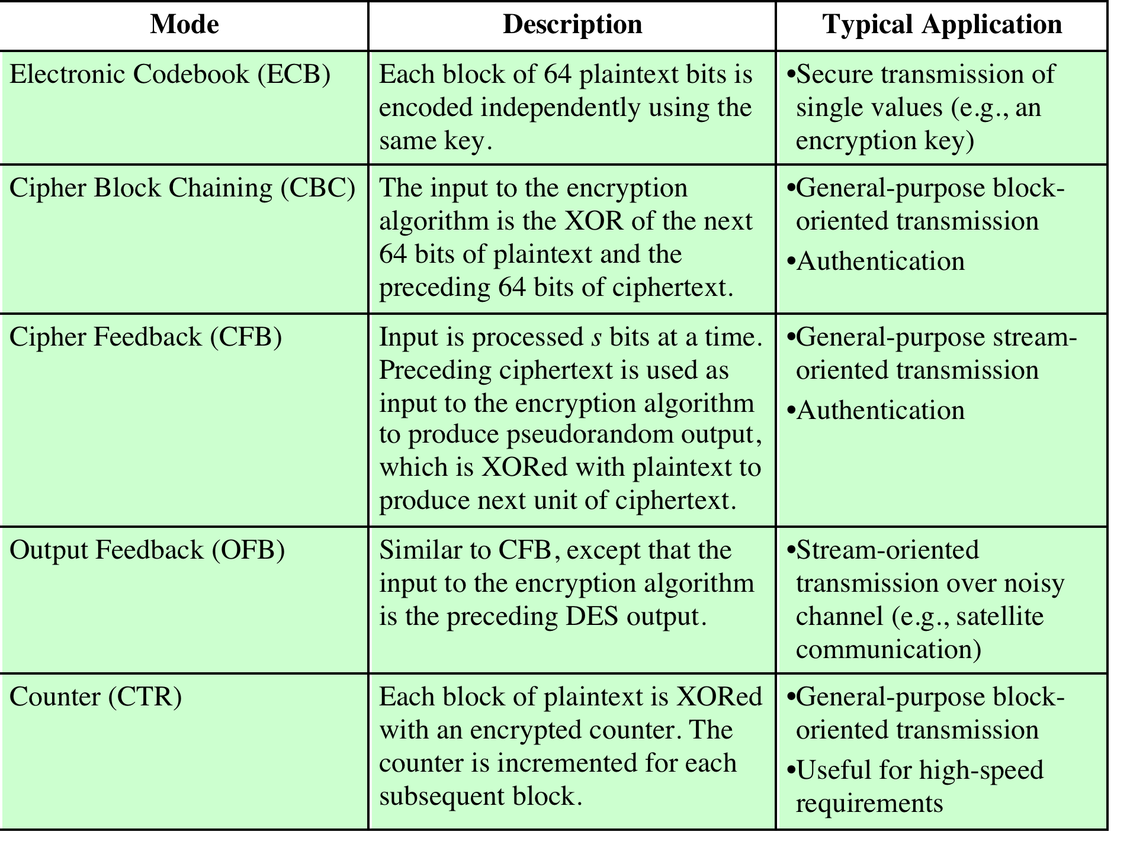
Table 20.3
Block Cipher Modes of Operation
Notes:
A symmetric block cipher processes one block of data at a time. In the case of DES
and 3DES, the block length is 64 bits. For longer amounts of plaintext, it is necessary
to break the plaintext into 64-bit blocks (padding the last block if necessary).
To apply a block cipher in a variety of applications, five modes of operation have
been defined by NIST SP 800-38A (Recommendation for Block Cipher Modes of Operation: Methods and Techniques, December 2001).
The five modes are intended to cover virtually all the possible applications of encryption for which a block cipher
could be used. These modes are intended for use with any symmetric block cipher,
including triple DES and AES. The modes are summarized in Table 20.3, and the
most important are described briefly in the remainder of this section.

Slide 31
Electronic Codebook (ECB)
Simplest mode
Plaintext is handled b bits at a time and each block is encrypted using the same key
“Codebook” is used because there is an unique ciphertext for every b-bit block of plaintext
Not secure for long messages since repeated plaintext is seen in repeated ciphertext
To overcome security deficiencies you need a technique where the same plaintext block, if repeated, produces different ciphertext blocks
Notes:
The simplest way to proceed is what is known as electronic codebook (ECB) mode,
in which plaintext is handled b bits at a time and each block of plaintext is encrypted
using the same key ( Figure 2.3a ). The term codebook is used because, for a given
key, there is a unique ciphertext for every b -bit block of plaintext. Therefore, one
can imagine a gigantic codebook in which there is an entry for every possible b -bit
plaintext pattern showing its corresponding ciphertext.
With ECB, if the same b -bit block of plaintext appears more than once in
the message, it always produces the same ciphertext. Because of this, for lengthy
messages, the ECB mode may not be secure. If the message is highly structured,
it may be possible for a cryptanalyst to exploit these regularities. For example, if
it is known that the message always starts out with certain predefined fields, then
the cryptanalyst may have a number of known plaintext-ciphertext pairs to work
with. If the message has repetitive elements, with a period of repetition a multiple
of b bits, then these elements can be identified by the analyst. This may help in the
analysis or may provide an opportunity for substituting or rearranging blocks.
To overcome the security deficiencies of ECB, we would like a technique in
which the same plaintext block, if repeated, produces different ciphertext blocks.

Slide 32
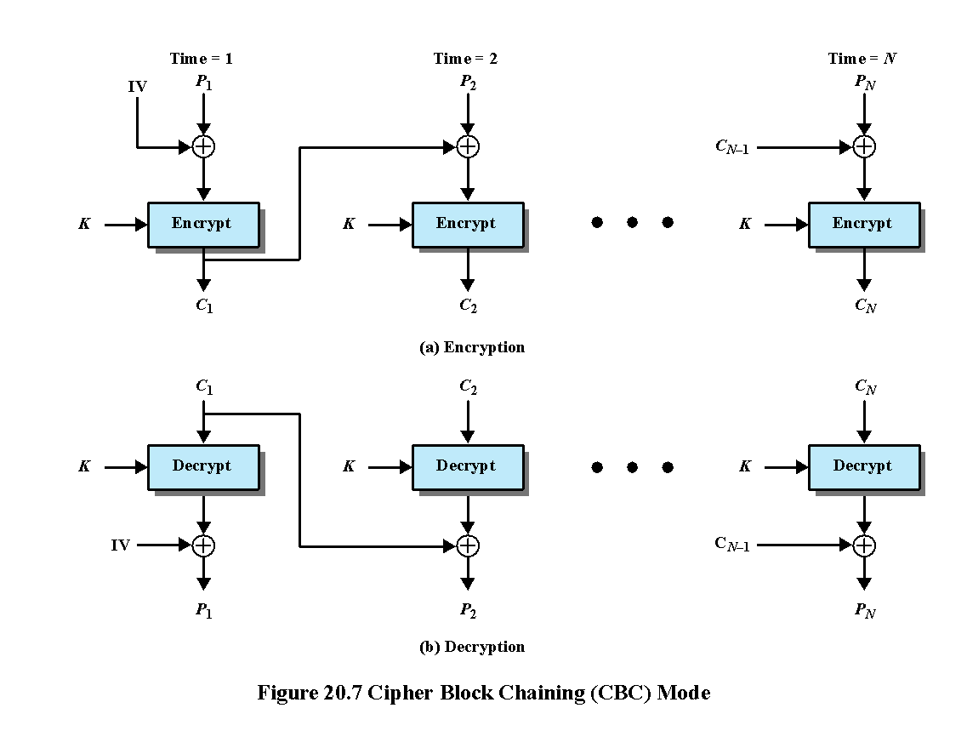
Notes:
In the cipher block chaining (CBC) mode (Figure 20.7), the input to the encryption algorithm is the XOR of the current plaintext block and the preceding ciphertext block; the same key is used for each block. In effect, we have chained together the processing of the sequence of plaintext blocks. The input to the encryption function for each plaintext block bears no fixed relationship to the plaintext block. Therefore, repeating patterns of b bits are not exposed.
For decryption, each cipher block is passed through the decryption algorithm. The result is XORed with the preceding ciphertext block to produce the plaintext block. To see that this works, we can write:
C_{j} = E(K, [C_{j–1} ⊕ P_{j}])
where E[K, X] is the encryption of plaintext X using key K, and ⊕ is the exclusive-OR operation.
To produce the first block of ciphertext, an initialization vector (IV) is XORed with the first block of plaintext. On decryption, the IV is XORed with the output of the decryption algorithm to recover the first block of plaintext.
The IV must be known to both the sender and receiver. For maximum security, the IV should be protected as well as the key. This could be done by sending the IV using ECB encryption. One reason for protecting the IV is as follows: If an opponent is able to fool the receiver into using a different value for IV, then the opponent is able to invert selected bits in the first block of plaintext.

Slide 33
Question.
Suppose an error occurs in a block of ciphertext on transmission using CBC. What effect is produced on the recovered plaintext blocks?
If an error occurs in transmission of ciphertext block Ci, then this error propagates to the recovered plaintext blocks Pi and Pi+1.

Slide 34
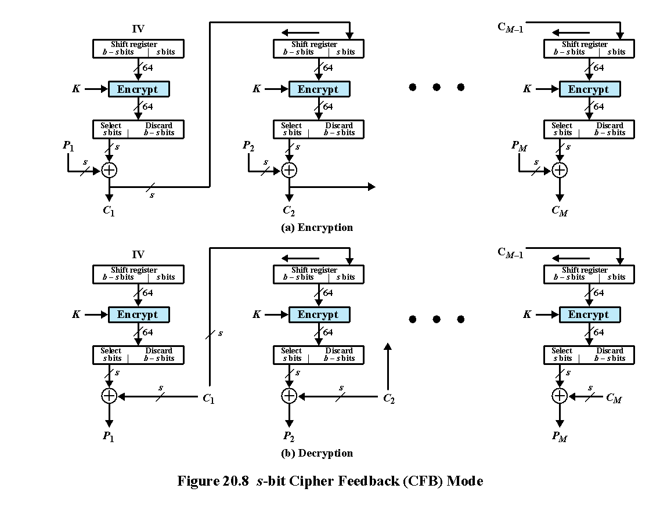
Notes:
It is possible to convert any block cipher into a stream cipher by using the cipher feedback (CFB) mode. A stream cipher eliminates the need to pad a message to be an integral number of blocks. It also can operate in real time. Thus, if a character stream is being transmitted, each character can be encrypted and transmitted immediately using a character-oriented stream cipher.
One desirable property of a stream cipher is that the ciphertext be of the same length as the plaintext. Thus, if 8-bit characters are being transmitted, each character should be encrypted using 8 bits. If more than 8 bits are used, transmission capacity is wasted.
Figure 20.8 depicts the CFB scheme. In the figure, it is assumed that the unit of transmission is s bits; a common value is s = 8. As with CBC, the units of plaintext are chained together so that the ciphertext of any plaintext unit is a function of
all the preceding plaintext.
First, consider encryption. The input to the encryption function is a b-bit shift register that is initially set to some initialization vector (IV). The leftmost (most significant) s bits of the output of the encryption function are XORed with the first unit of plaintext P₁ to produce the first unit of ciphertext C₁, which is then transmitted. In addition, the contents of the shift register are shifted left by s bits and C₁ is placed in the rightmost (least significant) s bits of the shift register. This process continues until all plaintext units have been encrypted.
For decryption, the same scheme is used, except that the received ciphertext unit is XORed with the output of the encryption function to produce the plaintext unit. Note that it is the encryption function that is used, not the decryption function. This is easily explained. Let S_{s}(X) be defined as the most significant s bits of X. Then
C₁ = P₁ ⊕ S_{s}[E(K, IV)]
Therefore
P₁ = C₁ ⊕ S_{s}[E(K, IV)]
The same reasoning holds for subsequent steps in the process.

Slide 35
Key Distribution
The means of delivering a key to two parties that wish to exchange data without allowing others to see the key
Two parties (A and B) can achieve this by:
A key could be selected by A and physically delivered to B
1
A third party could select the key and physically deliver it to A and B
2
If A and B have previously and recently used a key, one party could transmit the new key to the other, encrypted using the old key
3
If A and B each have an encrypted connection to a third party C, C could deliver a key on the encrypted links to A and B
4
Notes:
For symmetric encryption to work, the two parties to an exchange must share the
same key, and that key must be protected from access by others. Furthermore, frequent
key changes are usually desirable to limit the amount of data compromised if
an attacker learns the key. Therefore, the strength of any cryptographic system rests
with the key distribution technique, a term that refers to the means of delivering a
key to two parties that wish to exchange data, without allowing others to see the
key. Key distribution can be achieved in a number of ways. For two parties A and B,
1. A key could be selected by A and physically delivered to B.
2. A third party could select the key and physically deliver it to A and B.
3. If A and B have previously and recently used a key, one party could transmit
the new key to the other, encrypted using the old key.
4. If A and B each have an encrypted connection to a third party C, C could
deliver a key on the encrypted links to A and B.
Options 1 and 2 call for manual delivery of a key. For link encryption between two
directly-connected devices, this is a reasonable requirement, because each link encryption
device is only going to be exchanging data with its partner on the other end of the
link. However, for end-to-end encryption over a network, manual delivery is awkward.
In a distributed system, any given host or terminal may need to engage in exchanges with
many other hosts and terminals over time. Thus, each device needs a number of keys, supplied
dynamically. The problem is especially difficult in a wide area distributed system.
Option 3 is a possibility for either link encryption or end-to-end encryption, but
if an attacker ever succeeds in gaining access to one key, then all subsequent keys are
revealed. Even if frequent changes are made to the link encryption keys, these should
be done manually. To provide keys for end-to-end encryption, option 4 is preferable.

Slide 36
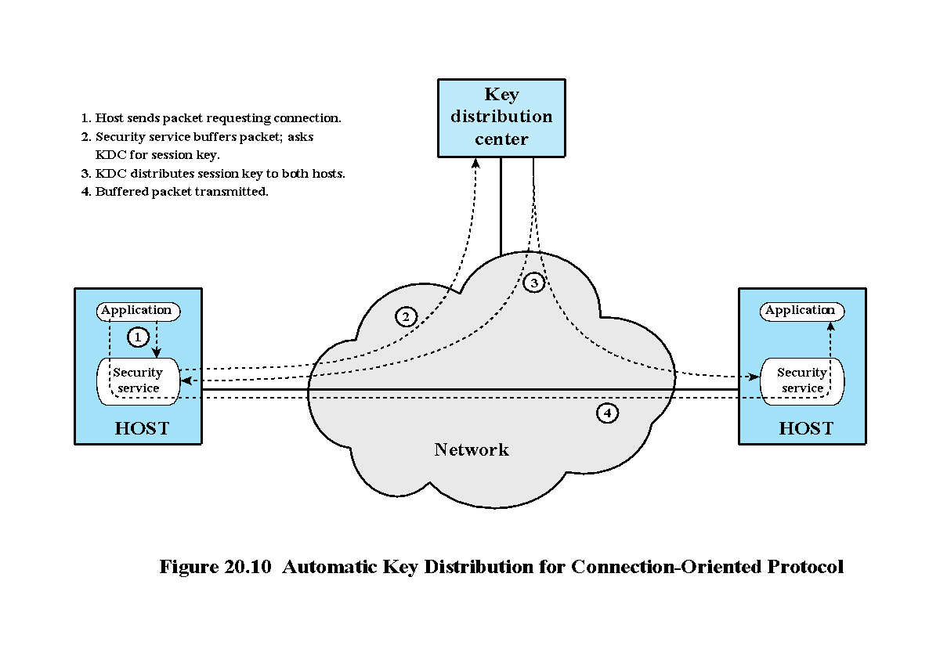
Notes:
Figure 20.10 illustrates an implementation that satisfies option 4 for end-to-end
encryption. In the figure, link encryption is ignored. This can be added, or not,
as required. For this scheme, two kinds of keys are identified:
• Session key: When two end systems (hosts, terminals, etc.) wish to communicate,
they establish a logical connection (e.g., virtual circuit). For the duration
of that logical connection, all user data are encrypted with a one-time session
key. At the conclusion of the session, or connection, the session key is
destroyed.
• Permanent key: A permanent key is a key used between entities for the purpose
of distributing session keys.
The configuration consists of the following elements:
• Key distribution center: The key distribution center (KDC) determines
which systems are allowed to communicate with each other. When permission
is granted for two systems to establish a connection, the KDC provides a
one-time session key for that connection.
• Security service module (SSM): This module, which may consist of functionality
at one protocol layer, performs end-to-end encryption and obtains session
keys on behalf of users.
The steps involved in establishing a connection are shown in Figure 20.10 . When
one host wishes to set up a connection to another host, it transmits a connection request
packet (step 1). The SSM saves that packet and applies to the KDC for permission
to establish the connection (step 2). The communication between the SSM and
the KDC is encrypted using a master key shared only by this SSM and the KDC. If the
KDC approves the connection request, it generates the session key and delivers it to
the two appropriate SSMs, using a unique permanent key for each SSM (step 3). The
requesting SSM can now release the connection request packet, and a connection is
set up between the two end systems (step 4). All user data exchanged between the two
end systems are encrypted by their respective SSMs using the one-time session key.
The automated key distribution approach provides the flexibility and dynamic
characteristics needed to allow a number of terminal users to access a number of
hosts and for the hosts to exchange data with each other.
Another approach to key distribution uses public-key encryption, which is
discussed in Chapter 21 .

Slide 37
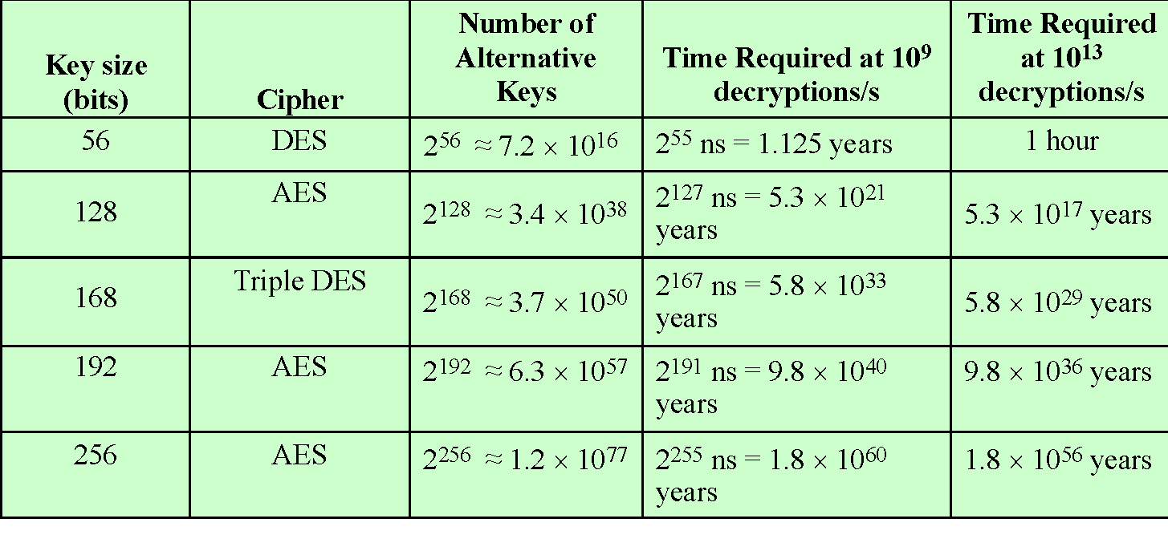
Table 2.2
Average Time Required for Exhaustive Key Search
Notes:
Table 2.2 shows how much time is required for
a brute-force attack for various key sizes. As can be seen, a single PC can break
DES in about a year; if multiple PCs work in parallel, the time is drastically shortened.
And today’s supercomputers should be able to find a key in about an hour.
Key sizes of 128 bits or greater are effectively unbreakable using simply a brute-force
approach. Even if we managed to speed up the attacking system by a factor
of 1 trillion (10¹² ), it would still take over 100,000 years to break a code using a
128-bit key.

Slide 38
Message Authentication
Protects against active attacks
Verifies received message is authentic
Contents have not been altered
From authentic source
Timely and in correct sequence
Can use conventional encryption
Only sender and receiver share a key
Notes:
Encryption protects against passive attack (eavesdropping). A different requirement
is to protect against active attack (falsification of data and transactions). Protection
against such attacks is known as message or data authentication.
A message, file, document, or other collection of data is said to be authentic
when it is genuine and came from its alleged source. Message or data authentication
is a procedure that allows communicating parties to verify that received or stored
messages are authentic. The two important aspects are to verify that the contents of
the message have not been altered and that the source is authentic. We may also wish
to verify a message’s timeliness (it has not been artificially delayed and replayed)
and sequence relative to other messages flowing between two parties. All of these
concerns come under the category of data integrity as described in Chapter 1.
It would seem possible to perform authentication simply by the use of symmetric
encryption. If we assume that only the sender and receiver share a key (which is
as it should be), then only the genuine sender would be able to encrypt a message
successfully for the other participant, provided the receiver can recognize a valid message.
Furthermore, if the message includes an error-detection code and a sequence
number, the receiver is assured that no alterations have been made and that sequencing
is proper. If the message also includes a timestamp, the receiver is assured that the
message has not been delayed beyond that normally expected for network transit.
In fact, symmetric encryption alone is not a suitable tool for data authentication.
To give one simple example, in the ECB mode of encryption, if an attacker
reorders the blocks of ciphertext, then each block will still decrypt successfully.
However, the reordering may alter the meaning of the overall data sequence.
Although sequence numbers may be used at some level (e.g., each IP packet), it is
typically not the case that a separate sequence number will be associated with each
b-bit block of plaintext. Thus, block reordering is a threat.

Slide 39
Message Authentication Without Confidentiality
Message encryption by itself does not provide a secure form of authentication
It is possible to combine authentication and confidentiality in a single algorithm by encrypting a message plus its authentication tag
Typically message authentication is provided as a separate function from message encryption
Situations in which message authentication without confidentiality may be preferable include:
There are a number of applications in which the same message is broadcast to a number of destinations
An exchange in which one side has a heavy load and cannot afford the time to decrypt all incoming messages
Authentication of a computer program in plaintext is an attractive service
Thus, there is a place for both authentication and encryption in meeting security requirements
Notes:
Because the approaches discussed in this section do not encrypt the message,
message confidentiality is not provided. As was mentioned, message encryption by
itself does not provide a secure form of authentication. However, it is possible to combine
authentication and confidentiality in a single algorithm by encrypting a message
plus its authentication tag. Typically, however, message authentication is provided as
a separate function from message encryption. [DAVI89] suggests three situations in
which message authentication without confidentiality is preferable:
1. There are a number of applications in which the same message is broadcast to
a number of destinations. Two examples are notification to users that the network
is now unavailable, and an alarm signal in a control center. It is cheaper
and more reliable to have only one destination responsible for monitoring
authenticity. Thus, the message must be broadcast in plaintext with an associated
message authentication tag. The responsible system performs authentication.
If a violation occurs, the other destination systems are alerted by a
general alarm.
2. Another possible scenario is an exchange in which one side has a heavy load and
cannot afford the time to decrypt all incoming messages. Authentication is carried
out on a selective basis, with messages being chosen at random for checking.
3. Authentication of a computer program in plaintext is an attractive service. The
computer program can be executed without having to decrypt it every time,
which would be wasteful of processor resources. However, if a message authentication
tag were attached to the program, it could be checked whenever assurance
is required of the integrity of the program.
Thus, there is a place for both authentication and encryption in meeting security
requirements.

Slide 40
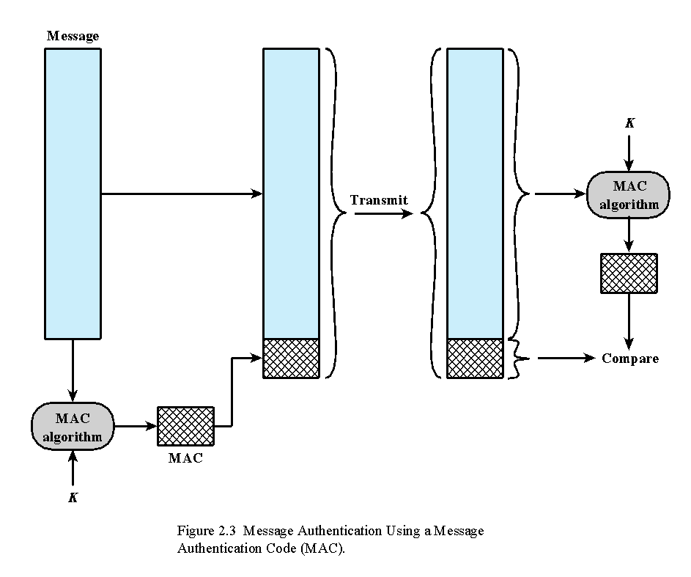
Notes:
One authentication technique involves
the use of a secret key to generate a small block of data, known as a message
authentication code, that is appended to the message. This technique assumes that
two communicating parties, say A and B, share a common secret key K_{AB}. When
A has a message to send to B, it calculates the message authentication code as a
complex function of the message and the key: MAC_{M} F(K_{AB}, M). The message
plus code are transmitted to the intended recipient. The recipient performs the same
calculation on the received message, using the same secret key, to generate a new
message authentication code. The received code is compared to the calculated code
(Figure 2.3). If we assume that only the receiver and the sender know the identity of
the secret key, and if the received code matches the calculated code, then
1. The receiver is assured that the message has not been altered. If an attacker
alters the message but does not alter the code, then the receiver’s calculation
of the code will differ from the received code. Because the attacker is assumed
not to know the secret key, the attacker cannot alter the code to correspond to
the alterations in the message.
2. The receiver is assured that the message is from the alleged sender. Because
no one else knows the secret key, no one else could prepare a message with a
proper code.
3. If the message includes a sequence number (such as is used with X.25, HDLC,
and TCP), then the receiver can be assured of the proper sequence, because
an attacker cannot successfully alter the sequence number.
A number of algorithms could be used to generate the code. The now withdrawn
NIST publication FIPS PUB 113 (Computer Data Authentication , May 1985),
recommended the use of DES. However AES would now be a more suitable choice.
DES or AES is used to generate an encrypted version of the message, and some of
the bits of ciphertext are used as the code. A 16- or 32-bit code used to be typical, but
would now be much too small to provide sufficient collision resistance, as we will
discuss shortly.
The process just described is similar to encryption. One difference is that the
authentication algorithm need not be reversible, as it must for decryption. It turns
out that because of the mathematical properties of the authentication function, it is
less vulnerable to being broken than encryption.

Slide 41
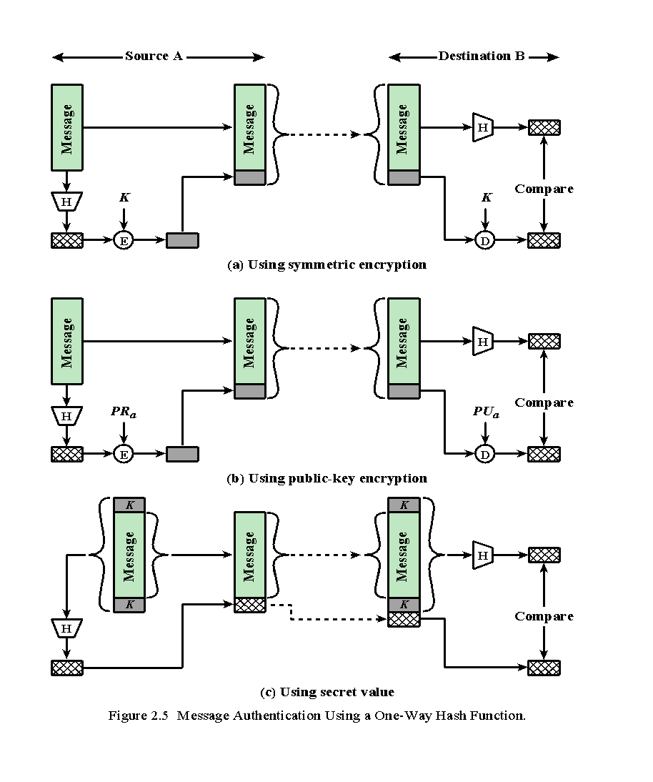
Notes:
Unlike the MAC, a hash function does not also take a secret key as input.
To authenticate a message, the message digest is sent with the message in such
a way that the message digest is authentic. Figure 2.5 illustrates three ways in
which the message can be authenticated using a hash code. The message digest
can be encrypted using symmetric encryption (part a); if it is assumed that only
the sender and receiver share the encryption key, then authenticity is assured. The
message digest can also be encrypted using public-key encryption (part b); this is
explained in Section 2.3. The public-key approach has two advantages: It provides
a digital signature as well as message authentication; and it does not require the
distribution of keys to communicating parties.
These two approaches have an advantage over approaches that encrypt the
entire message in that less computation is required. But an even more common approach is
the use of a technique that avoids encryption altogether. Several reasons
for this interest are pointed out in [TSUD92]:
• Encryption software is quite slow. Even though the amount of data to be
encrypted per message is small, there may be a steady stream of messages into
and out of a system.
• Encryption hardware costs are non-negligible. Low-cost chip implementations
of DES are available, but the cost adds up if all nodes in a network must have
this capability.
• Encryption hardware is optimized toward large data sizes. For small blocks of
data, a high proportion of the time is spent in initialization/invocation overhead.
• An encryption algorithm may be protected by a patent.
Figure 2.5c shows a technique that uses a hash function but no encryption
for message authentication. This technique, known as a keyed hash MAC, assumes
that two communicating parties, say A and B, share a common secret key K.
This secret key is incorporated into the process of generating a hash code. In the
approach illustrated in Figure 2.5c, when A has a message to send to B, it calculates
the hash function over the concatenation of the secret key and the message:
MD_{M} = H(K ll M ll K). It then sends [ M ii MD_{M}] to B. Because B possesses K, it can
recompute H(K ll M ll K) and verify MD_{M}. Because the secret key itself is not sent, it
should not be possible for an attacker to modify an intercepted message. As long as
the secret key remains secret, it should not be possible for an attacker to generate a
false message.
Note that the secret key is used as both a prefix and a suffix to the message. If
the secret key is used as either only a prefix or only a suffix, the scheme is less secure.
This topic is discussed in Chapter 21. Chapter 21 also describes a scheme known
as HMAC, which is somewhat more complex than the approach of Figure 2.5c and
which has become the standard approach for a keyed hash MAC.

Slide 42
To be useful for message authentication, a hash function H must have the following properties:
Can be applied to a block of data of any size
Produces a fixed-length output
H(x) is relatively easy to compute for any given x
One-way or pre-image resistant
Computationally infeasible to find x such that H(x) = h
Computationally infeasible to find y ≠ x such that H(y) = H(x)
Collision resistant or strong collision resistance
Computationally infeasible to find any pair (x,y) such that H(x) = H(y)
Notes:
The purpose of a hash function is to produce a
“fingerprint” of a file, message, or other block of data. To be useful for message
authentication, a hash function H must have the following properties:
1. H can be applied to a block of data of any size.
2. H produces a fixed-length output.
3. H(x) is relatively easy to compute for any given x, making both hardware and
software implementations practical.
4. For any given code h, it is computationally infeasible to find x such that
H(x) h. A hash function with this property is referred to as one-way or preimage
resistant.
5. For any given block x, it is computationally infeasible to find y ≠ x with
H(y) H(x). A hash function with this property is referred to as second preimage
resistant. This is sometimes referred to as weak collision resistant.
6. It is computationally infeasible to find any pair (x, y) such that H(x) H(y).
A hash function with this property is referred to as collision resistant. This is
sometimes referred to as strong collision resistant.
The first three properties are requirements for the practical application of a hash
function to message authentication.
The fourth property is the one-way property: It is easy to generate a code given a
message, but virtually impossible to generate a message given a code. This property is
important if the authentication technique involves the use of a secret value (Figure 2.5c).
The secret value itself is not sent; however, if the hash function is not one way, an attacker
can easily discover the secret value: If the attacker can observe or intercept a transmission,
the attacker obtains the message M and the hash code MD_{M} = H(K || M || K). The attacker
then inverts the hash function to obtain K || M || K = H⁻¹(MD_{M}). Because the attacker now
has both M and K || M || K, it is a trivial matter to recover K.
The fifth property guarantees that it is impossible to find an alternative
message with the same hash value as a given message. This prevents forgery when
an encrypted hash code is used (Figures 2.5a and b). If this property were not true,
an attacker would be capable of the following sequence: First, observe or intercept
a message plus its encrypted hash code; second, generate an unencrypted hash code
from the message; third, generate an alternate message with the same hash code.
A hash function that satisfies the first five properties in the preceding list is
referred to as a weak hash function. If the sixth property is also satisfied, then it
is referred to as a strong hash function. A strong hash function protects against an
attack in which one party generates a message for another party to sign. For example,
suppose Bob gets to write an IOU message, send it to Alice, and she signs it.
Bob finds two messages with the same hash, one of which requires Alice to pay a
small amount and one that requires a large payment. Alice signs the first message
and Bob is then able to claim that the second message is authentic.

Slide 43
Security of Hash Functions
There are two approaches to attacking a secure hash function:
SHA most widely used hash algorithm
Additional secure hash function applications:
Cryptanalysis
Exploit logical weaknesses in the algorithm
Passwords
Hash of a password is stored by an operating system
Brute-force attack
Strength of hash function depends solely on the length of the hash code produced by the algorithm
Intrusion detection
Store H(F) for each file on a system and secure the hash values
Notes:
As with symmetric encryption, there are two
approaches to attacking a secure hash function: cryptanalysis and brute-force attack.
As with symmetric encryption algorithms, cryptanalysis of a hash function involves
exploiting logical weaknesses in the algorithm.
The strength of a hash function against brute-force attacks depends solely on
the length of the hash code produced by the algorithm.
For a hash code of length n,
the level of effort required is proportional to the following:
Preimage resistant 2n
Second preimage resistant 2n
Collision resistant 2n/2
If collision resistance is required (and this is desirable for a general-purpose
secure hash code), then the value 2n/2 determines the strength of the hash code against
brute-force attacks. Van Oorschot and Wiener [VANO94] presented a design for a
$10 million collision search machine for MD5, which has a 128-bit hash length, that
could find a collision in 24 days. Thus a 128-bit code may be viewed as inadequate.
The next step up, if a hash code is treated as a sequence of 32 bits, is a 160-bit hash
length. With a hash length of 160 bits, the same search machine would require over
four thousand years to find a collision. With today’s technology, the time would be
much shorter, so that 160 bits now appears suspect.
In recent years, the most widely used
hash function has been the Secure Hash Algorithm (SHA). SHA was developed
by the National Institute of Standards and Technology (NIST) and published as
a federal information processing standard (FIPS 180) in 1993. When weaknesses
were discovered in SHA, a revised version was issued as FIPS 180-1 in 1995 and is
generally referred to as SHA-1. SHA-1 produces a hash value of 160 bits. In 2002,
NIST produced a revised version of the standard, FIPS 180–2, that defined three
new versions of SHA, with hash value lengths of 256, 384, and 512 bits, known as
SHA-256, SHA-384, and SHA-512. These new versions have the same underlying
structure and use the same types of modular arithmetic and logical binary operations
as SHA-1. In 2005, NIST announced the intention to phase out approval of SHA-1
and move to a reliance on the other SHA versions by 2010. As discussed in Chapter
21, researchers have demonstrated that SHA-1 is far weaker than its 160-bit hash
length suggests, necessitating the move to the newer versions of SHA.
We have discussed the use of hash functions for message authentication and for the
creation of digital signatures (the latter is discussed in more detail later in this chapter).
Here are two other examples of secure hash function applications:
• Passwords: Chapter 3 explains a scheme in which a hash of a password is
stored by an operating system rather than the password itself. Thus, the actual
password is not retrievable by a hacker who gains access to the password file.
In simple terms, when a user enters a password, the hash of that password is
compared to the stored hash value for verification. This application requires
preimage resistance and perhaps second preimage resistance.
• Intrusion detection: Store H(F) for each file on a system and secure the hash
values (e.g., on a CD-R that is kept secure). One can later determine if a file has
been modified by recomputing H(F). An intruder would need to change F without
changing H(F). This application requires weak second preimage resistance

Slide 44
Summary
Symmetric encryption principles
Cryptography
Cryptanalysis
Feistel cipher structure
Data encryption standard
Data encryption standard
Triple DES
Advanced encryption standard
Overview of the algorithm
Algorithm details
Stream ciphers and RC4
Stream cipher structure
The RC4 algorithm
Cipher block modes of operation
Electronic codebook mode
Cipher block chaining mode
Cipher feedback mode
Counter mode
Key distribution
Notes:
Chapter 20 summary.

